Slide 1
CS 580 Research Project: Reinforcement Learning
Aaron Yang, Mike Riches, Ruochen Hua

Slide 2
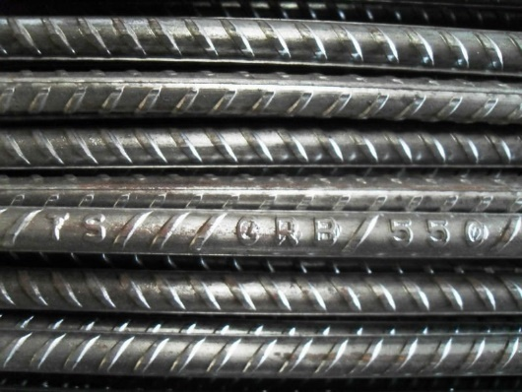
Reinforcement Learning
What is RL?
Why use it?
Implementation
Experimental results
Real world scenarios
Demos!

Slide 3

What is RL?
RL teaches an AI agent how to play a game
Simulates “Cause-and-effect”
Unsupervised learning

Slide 4
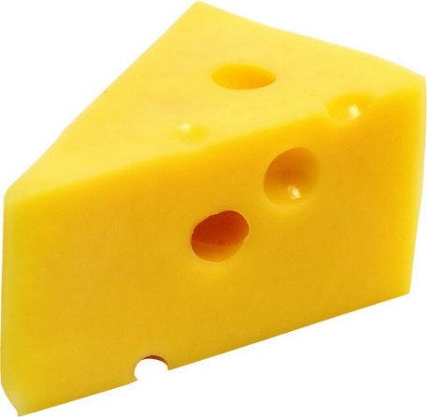
What is RL?
Stores, updates, and uses a Policy
Policy provides best action for a given game state
“Q-value” is assigned to each possible action
Success or failure influences the Q-value for an action taken
“Cause-and-effect”
Repeat successful actions
Avoid unsuccessful actions

Slide 5

Benefits of RL
Agents provide challenging gameplay
RL can respond to player's actions
RL can provide better challenges
More replay value
Produce intelligent “agents”
Provide challenging gameplay
Add replay value
Respond to player's style and choices

Slide 6

Implementation choices
Can be used offline or online – or both!
Game state representation
Pick and choose the parameters you think should apply
Represent only the state that applies to RL agent
Must represent all possible combinations
Memory storage: size vs. speed

Slide 7

RL Challenges
Many “epochs” required
Bake smart agents
Can still use gameplay
Balancing new choices vs. learned choices
Learned methods might not fit new situations
Use randomness to introduce new methods
Pick best algorithm
Q-Learning
SARSA
???

Slide 8

Q-Learning
Q-value: The potential value of taking a particular action, given a particular state of the game.
Higher Q-value == better action
Q-Learning workflow:
Choose best action by looking in the policy.
Take the action.
Observe the reward value, if any.
Update the Q-value for that action in that game state, using the observed reward.
On the next turn, start again at Step 1.

Slide 9
Sarsa

Slide 10
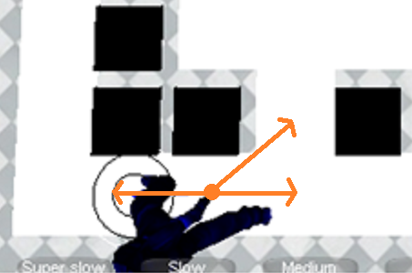
Rules: Cat versus Mouse
Square grid
Move in 8 directions
One move per turn
Walls block moves
Can move diagonally
Random starting points

Slide 11
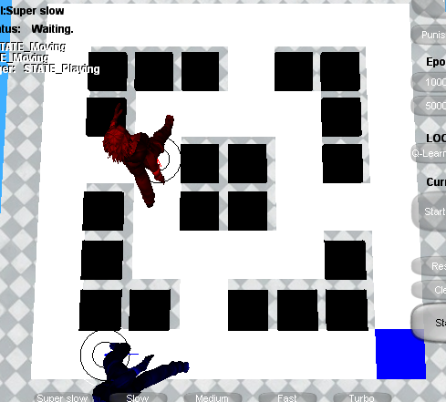
Rules: Cat versus Mouse
Cat moves toward mouse.
Mouse moves toward cheese without getting caught.
If Mouse gets the cheese:
++mouseScore
Move cheese
If Cat gets the mouse:
++catScore
Game over!
Success ratio

Slide 12

Gameplay demo

Slide 13
Q-Learning in this game
Q-value: the evaluated value of moving mouse to 8 directions.
State: positions of mouse, cat and cheese.
Choose an action(move direction) base on learned data(policy).
Take the action and observe the reward. Got cheese, Reward= +50 . Caught by cat, Reward=-100.
Update Q-value for the state using the observed reward
Go to Step 1.

Slide 14
Technique and Implementation
Rabin’s framework and c++
Rlearner: run learning algorithm and update policy.
RLPolicy: a database to store Q-value
Rlworld: a presentation of a game environment.
RLGame: control the game overflow and maintain all setting.
Update UI
RLGame
run training
RLearner
RLWorld
query action
RLPolicy
Update policy

Slide 15
Show time!
greedy and smart.
Before and after training.
The more iterations you run, the smarter mouse you will get.
different terrains.
When reward is larger than penalty, mouse will go for the cheese no matter what.
Other factors

Slide 16
Games using reinforcement learning
Board games
Strategy games
Fighting games
Racing games
In research

Slide 17
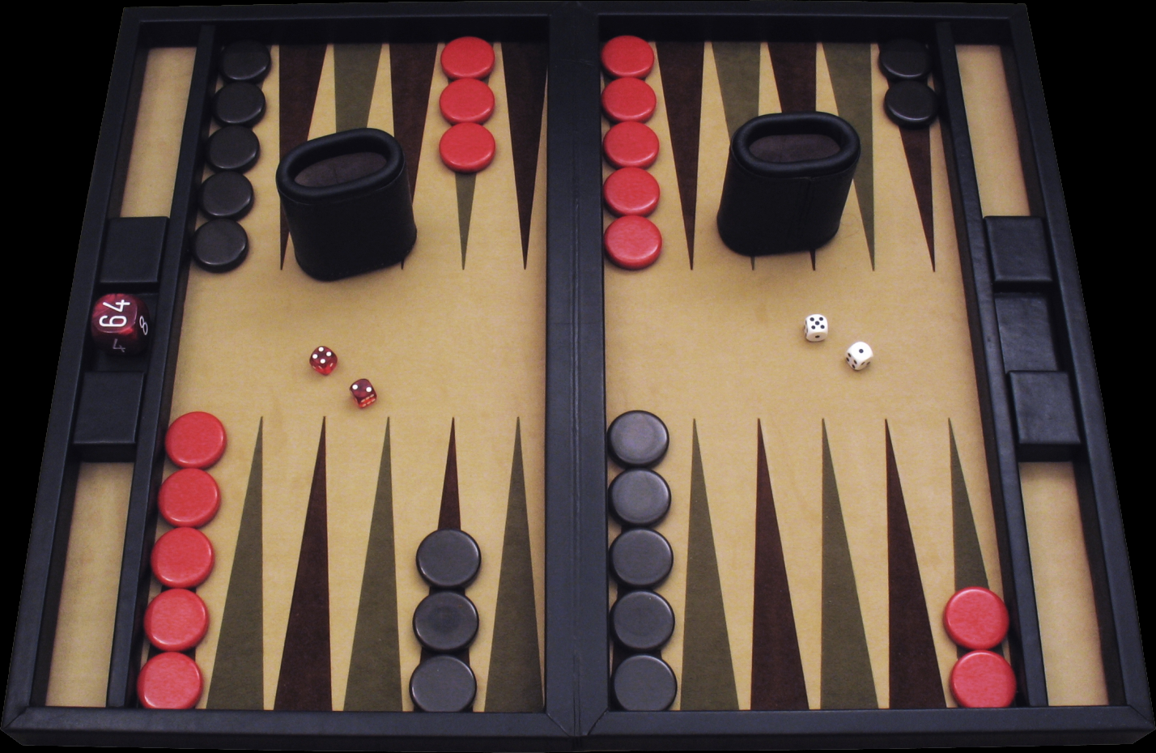
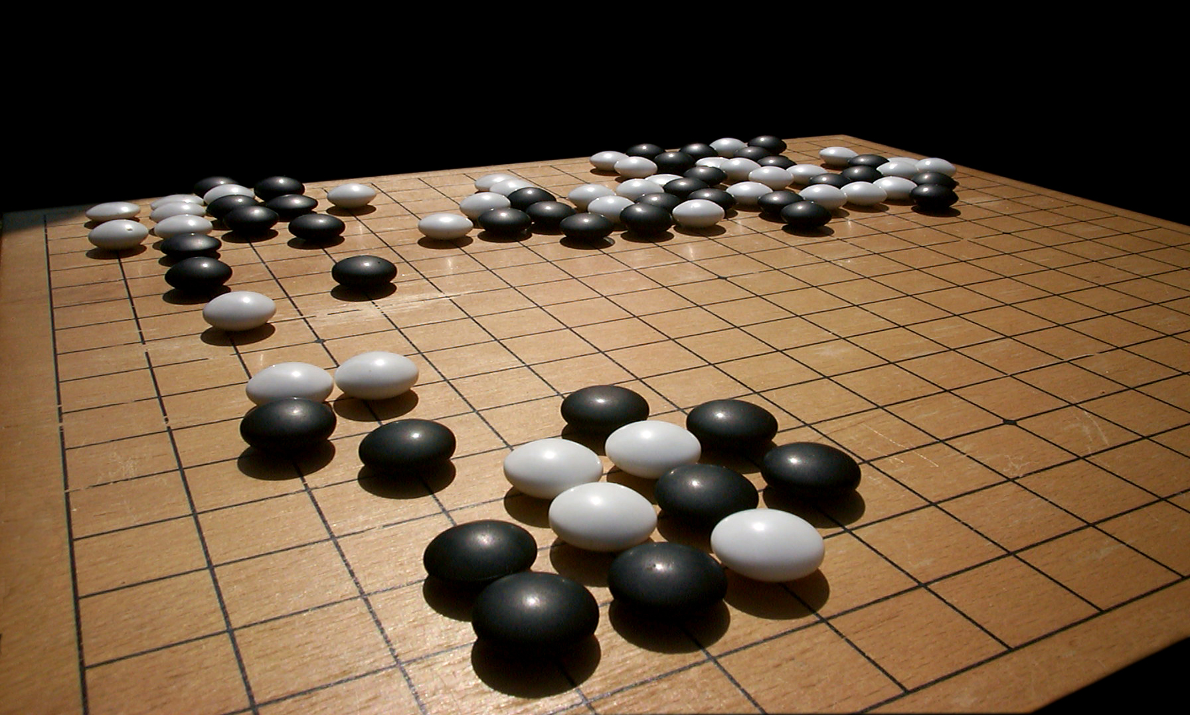
Board games
GO
Backgammon

Slide 18
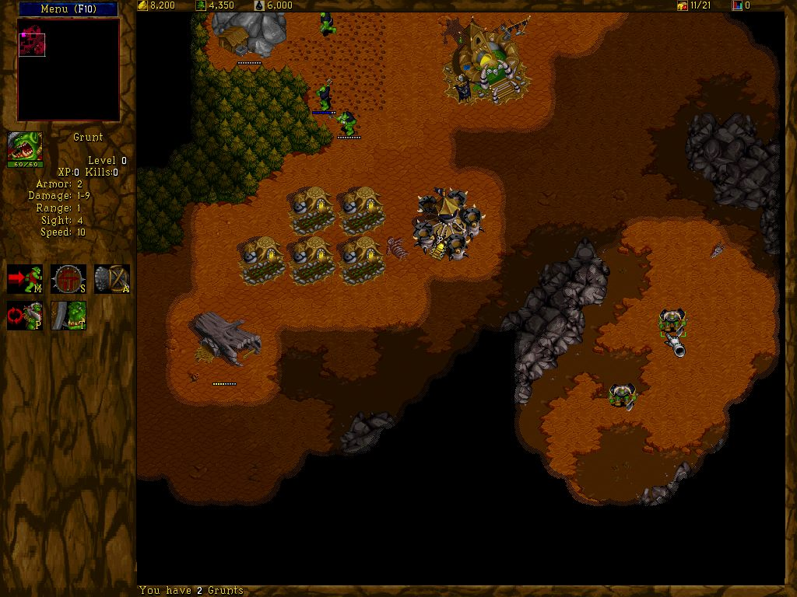
Strategy games
Wargus

Slide 19

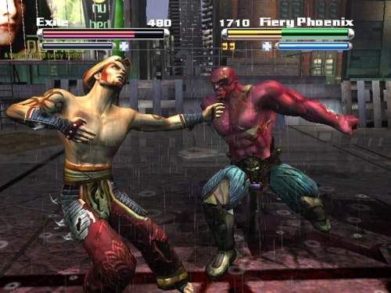
Fighting games
Tao Feng

Slide 20

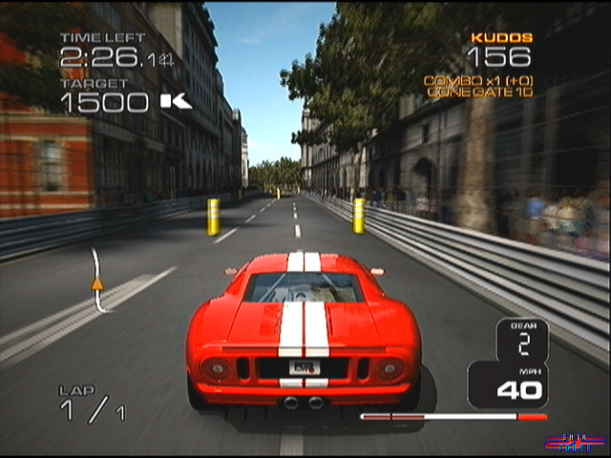
Racing games
Project Gotham Racing 3

Slide 21
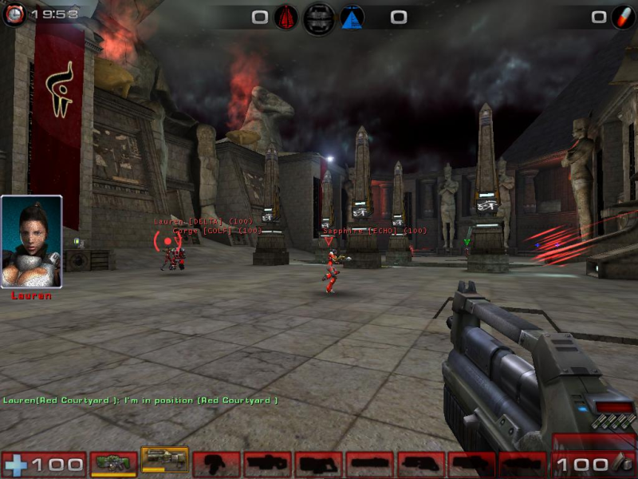
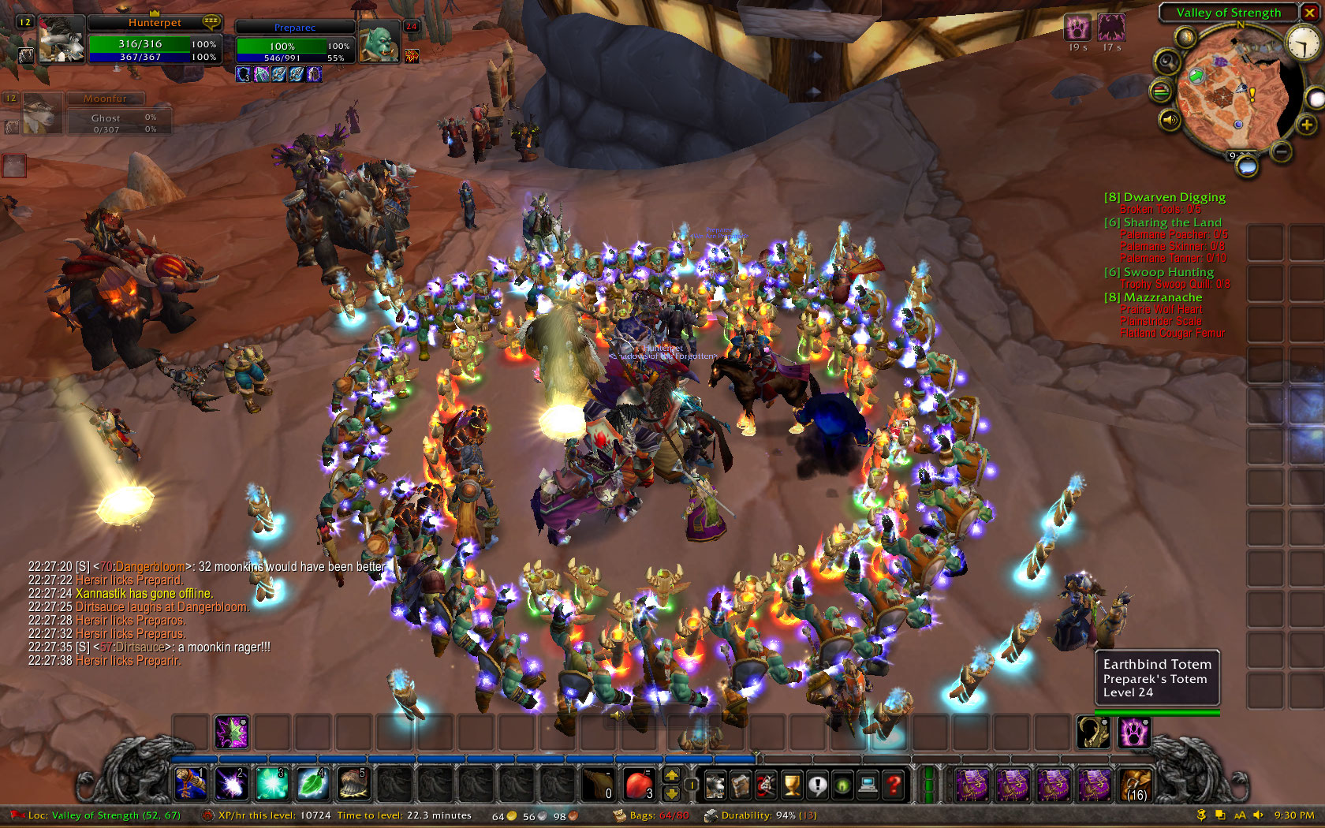
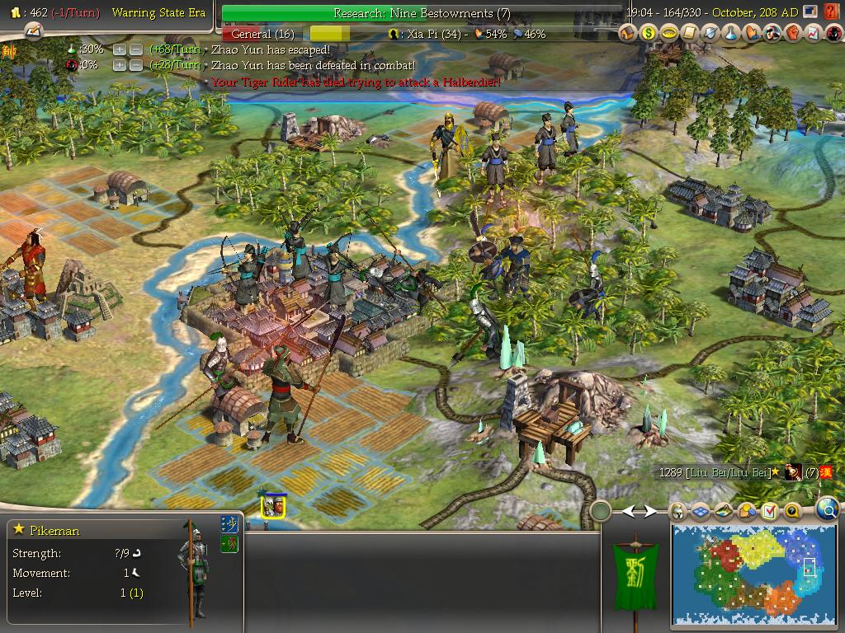
In research
World of Warcraft
Unreal tournament
CIvilizatin

